Slide 1
Take-Home Data Challenge
Goal: Analyze food access disparities across U.S. counties and estimate the impact of intervention programs
Datasets Used:
Census Data: Population demographics, food insecurity, health indicators
[Source]
USDA Food Environment Atlas: Access to grocery stores, participation in SNAP (food stamps), free lunch programs, and poverty rates.
[Source]

Slide 2


Data Preprocessing & Merging
Steps Taken:
✔ Feature Selection: Key variables related to food insecurity & access.
✔ FIPS Standardization: Unified county-level data.
✔ Missing Data Handling: Imputed missing PCT_FREE_LUNCH15 values.
✔ Final Merged Dataset: Unified dataset combining Census & Food Atlas metrics.

Slide 3
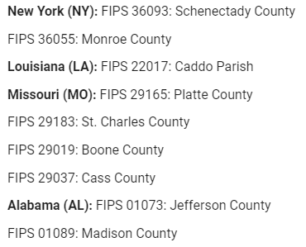
Where Should We Deploy a Food Access Program?
✔ Identified counties where:
≥30% population has low food access (USDA threshold)
≥15% food insecurity rate (Feeding America threshold)
✔ Priority Areas Identified:
Counties from New York, Alabama, Missouri, Louisiana as top need areas.

Slide 4
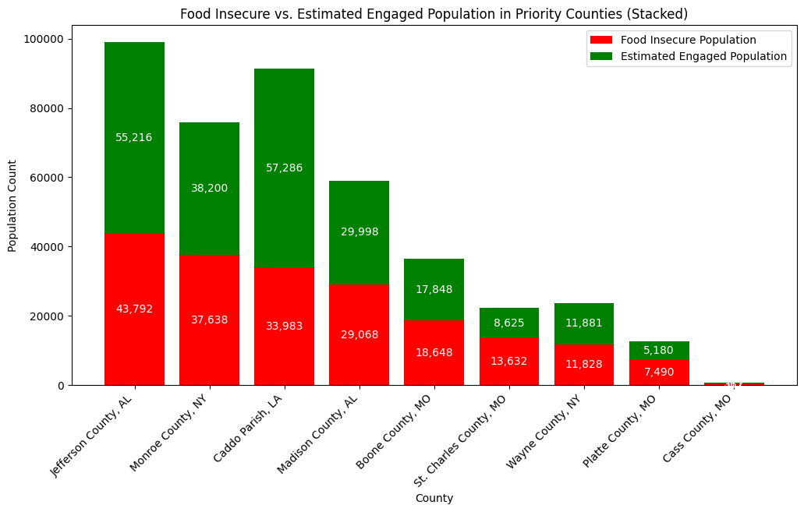
How many people will be included? How many might be successfully engaged?
Increase outreach in Boone County, MO, where food insecurity is high but engagement remains low.
Focus intervention efforts on Jefferson County, AL, Monroe County, NY, and Caddo Parish, LA, where the largest populations face food insecurity.
Enhance engagement strategies in St. Charles County, MO, and Wayne County, NY, to close the gap between food insecurity and program participation.

Slide 5
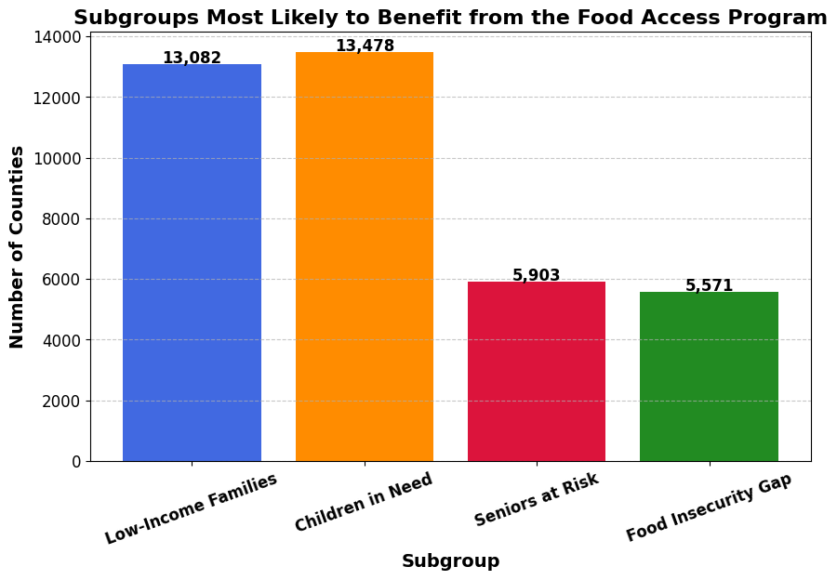
Who Benefits the Most? Identifying Subgroups
Children in Need: 13,478 counties – Highest priority group. Expanding food programs in schools is crucial.
Low-Income Families: 13,082 counties – Strong need for SNAP and food assistance expansion.
Seniors at Risk: 5,903 counties – Limited SNAP access. Targeted outreach required.
Food Insecurity Gap: 5,571 counties – High food insecurity but low aid coverage. Increase program awareness.
Action: Prioritize children and low-income families while bridging gaps for seniors and under-supported areas.

Slide 6
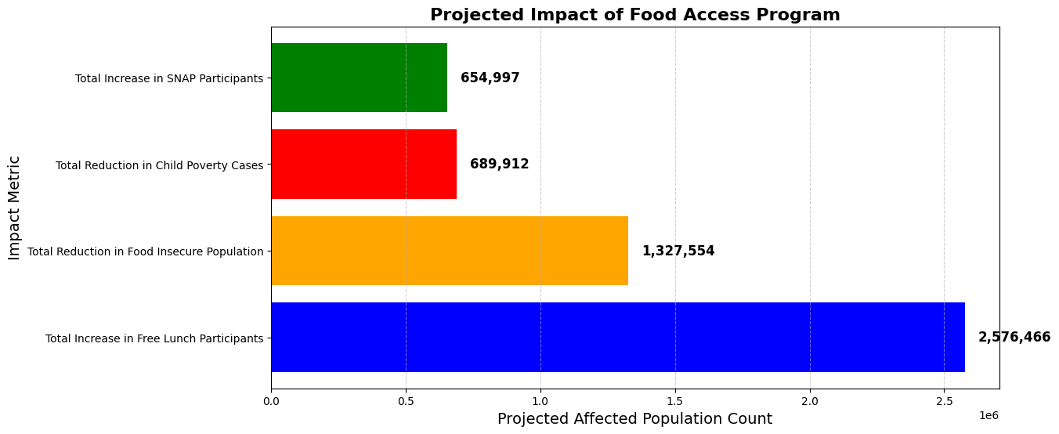
What is the projected impact of this program?
Projected Benefits:
1.3M fewer food-insecure people
650K more SNAP participants
2.5M additional free lunch participants
690K fewer children in poverty

